Slide 1

Leveraging Quality Prediction Models for Automatic Writing Feedback
Hamed Nilforoshan + Eugene Wu
hn2284@columbia.edu ewu@cs.columbia.edu
Notes:
Hi, my name is Hamed, I’m undergrad Columbia
This is a presentation of my work with Professor Eugene Wu
On techniques to automatically generate writing feedback, with a focus on social media

Slide 2







Reviews
Articles
Answers
Reviews
Listings
Everything
Notes:
Today, social media depends HEAVILY
On their users to provide them with high quality writing like reviews, answers, and more.
All of these services want *high quality* writing.

Slide 3

Not Everybody Writes Quality Content
Reviews
Notes:
But not everybody knows how to write quality content
For now, let’s talk about Amazon reviews as an example, which is one of many platforms where user generated text is important.
On Amazon reviews are often downvoted for being low quality or not meeting community guidelines. Here’s an example of a review.
The user clearly wanted to tell us we shouldn’t buy the product, but she’s so vague that the review isn’t actually helpful to shopper. The review was downvoted by other user, whiich in many cases prevents it from being seen, to give attention to other reviews.
Why do people fail to produce high-quality content on social media?
----
Want quality content, quality is an amorphous content, detailed feedback, quality goes beyond syntactic things.

Slide 4
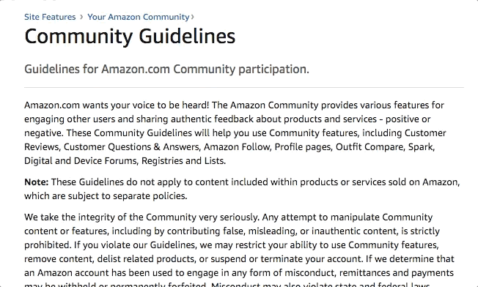
Quality is Complicated
Reviews
Notes:
Well that’s because quality is complicated.
Each social platform has its own norms for high-quality writing, and fully understanding these norms can require a LOT of reading.
As an example, here are the multiple pages of community guidelines you’d have to read on Amazon to fully understand how to write a high-quality review.
Most social platforms have a page like this which is often ignored by users.
So how can we improve online writing?

Slide 5
But is Hard to Scale to the Internet
Feedback Helps People Write Better
Notes:
Intuitively, feedback helps people write better, and ideally we would want to scale that to the internet, which is difficult a the moment.

Slide 6
Limited to Grammar, Spelling, etc.
Online Writing Feedback
Notes:
The closest thing to automated writing feedback online are
services like grammarly try to provide online writing feedback, but the feedback is limited to simple mistakes like spelling and syntax issues like grammar.
This limits how helpful the feedback can be on social media, where good spelling and grammar is,at best, only one of the characteristics of high quality content people are looking for.
For example, Going back to the amazon example, its much more important for your review to provide relevant product information to shoppers, than for the commas to be in the right places.
Imagine detailed writing feedback that tells you not just simple mistakes but points out all the areas are falling short of a *specific communities* norms, and how to get there. For example, feedback that gives you suggestions on things like your tone, specificity, or even tells you what is missing that you didn’t write about that you can add.
That’s the vision that we are working towards.

Slide 7
What is high-quality writing on a given social network?
Notes:
To work towards that vision, the first question we had to ask is for a given social network or platform, WHAT IS HIGH QUALITY

Slide 8
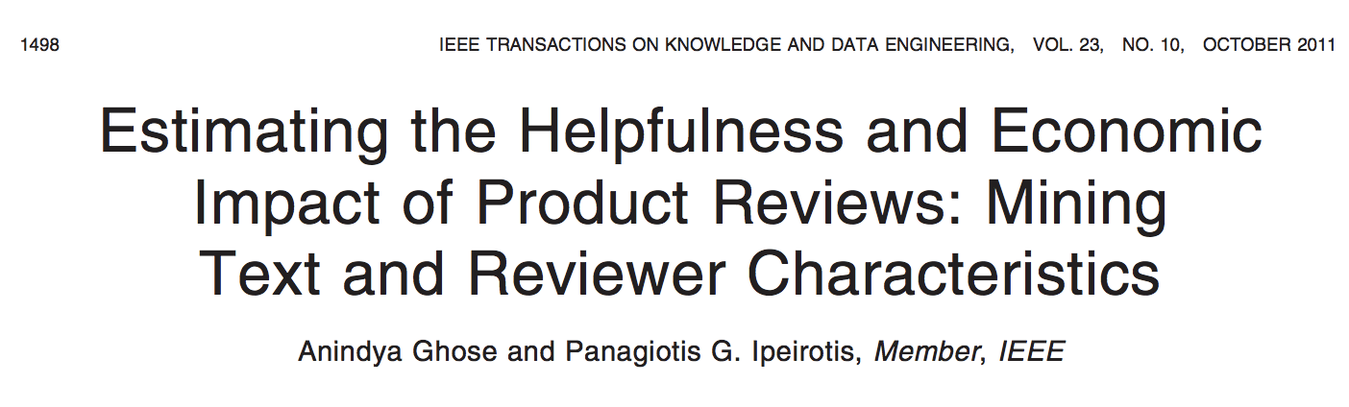
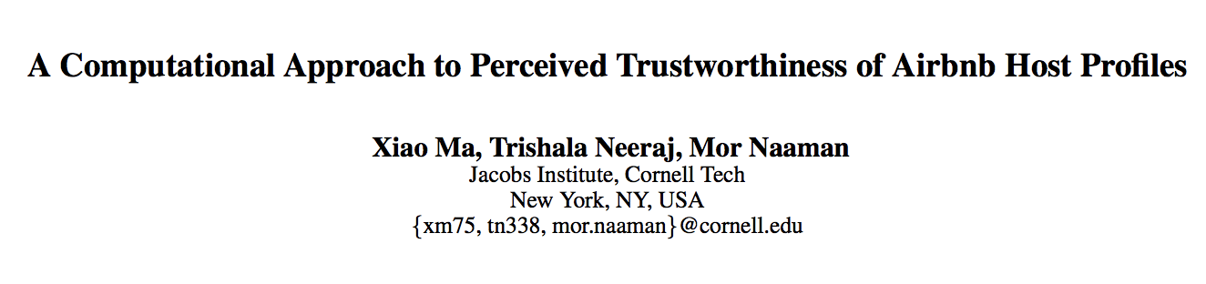
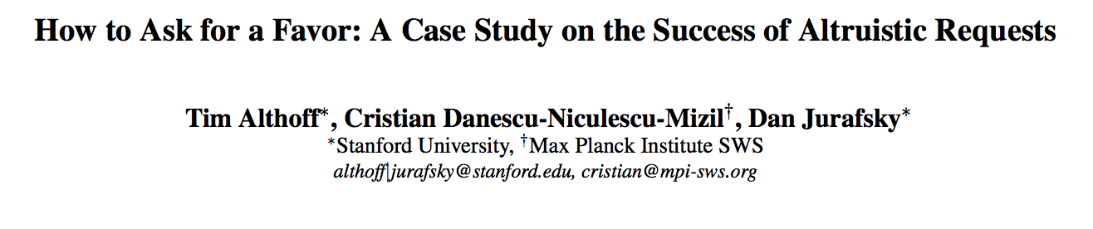
Existing Social Text Quality Prediction Models
Notes:
The best answer we found to that question is with quality prediction model
People have developed robust models to identity quality writing for a variety of different contexts.
Youc an predict if an amzon review helpful, a prfoile on airbnb is trustworthy, or even if a request for pizza will be answered on reddit.

Slide 9
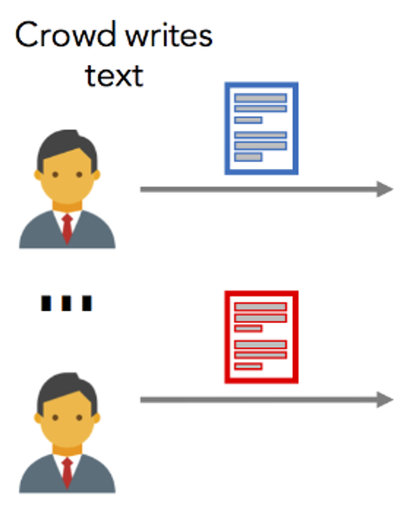

Models descriptive, we want normative outputs
From Prediction Models to Feedback
X₁
X₂
.
.
.
X_{n}
Low Quality
?
High Quality
Features
(i.e Word Count, Sentiment)
Model
Notes:
The main benefit of these existing papers is that they first identify which features to extract for a particular domain.
So what is missing to give feedback? What these models don’t answer if, a document has been classified as low quality, what is the most efficient way to improve it.
In other words, models are descriptive, not normative.
------
Main intuition is these features correspond to characteristics of the text
If changing these characteristics → might make model decide its high quality
Good suggestions
Work that does it in general
Sometimes changing characteristics like word count might not be enough, (more positive + talk more) need to take combinatons into account – can be reallly expensive, try all combinations and all ways of changing them
In general our approach is to know about the kind of model and speciically literature focuses on random forests and these are things we can anlyze directlys
---
How can the writing be changed so the model thinks its high quality
Maybe increase the emotion/length → improve quality
Not clear up front which combinationsare good. In the worst case might have to try all combinations and try all ways of changing those features
---- expensive because it’s a black box, the opportunity we see is the dominant model is random forests, these are models where we know everything about how they make decisions and we can leverage that fact

Slide 10
Our Contribution
Perturbation Analysis
To generate feedback most likely to improve document quality

Slide 11
Perturbation Analysis Intuition
Low Quality
Word count = 10
Emotion= 30
Perturbation +20
High Quality
Features
Model
Notes:
Main intuition is a model’s features correspond to characteristics of the text
If for a low quality document, changing these characteristics makes model decide the document high quality
Good suggestions
For example lets say there are two features, word count and emotion.
Somebody writes a document with a word count of 10 and and emotion of 30, which the model decides is low quality.
Now let’s say we increase the word count by 20. We refer to this increase as a PERTURBATION. Now let’s say that the model changes its mind at decides this document is high quality. Then increasing the length of the document is probably good feedback.
So what’s difficult about doing this naively?

Slide 12
In complex models, feature interactions matter
Not possible to look at every possible perturbation
Notes:
Sometimes changing characteristics like word count might not be enough. Complex models look at feature interactions, so to find the best pertuarbations you need to take combinations into account. For example, to both increase word count AND emotion.
This can be really time-expensive, because you’d have to try all combinations of features and all the ways of changing the.
So how can make this process more efficient?

Slide 13
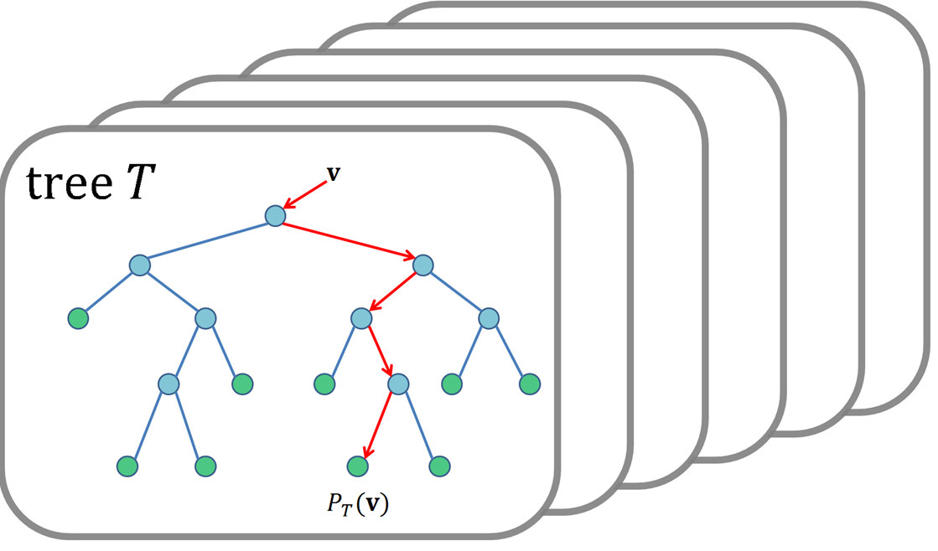
Existing Social Text Quality Prediction Models
Notes:
Going back to the models that work well, what we find is that tree ensembles, such as random forests, are really a popular, well-performing choice
Our idea here is instead of treating the model as a black box, what if we actually inspect its structure to find the perturbations that will improve quality the most.

Slide 14
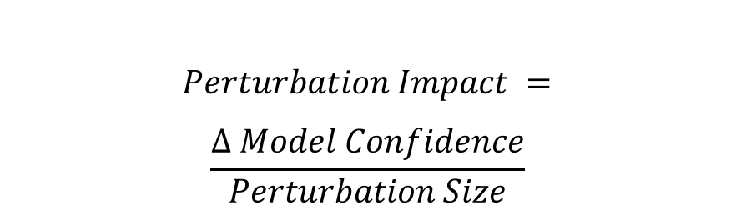

Feature Selection
$$Perturbation Impact =$$
$$\frac{∆ Model Confidence}{Perturbation Size}$$
d = (word count=10, emotion=30)
word count > 20
p² Impact = 0.75 / 2 = 0.375
emotion > 10
emotion > 15
p¹ Impact = 0.95 / 1 = 0.95
High
Quality
Low
Quality
High
Quality
Low
Quality
Low
Quality
$$Feature Impact=$$
$$Σ Relevant Perturbations$$
95% confidence
75% confidence
p¹ = (word count=0, emotion=-20)
Word Count Impact = 0.375
p² = (word count=10, emotion=-15)
Emotion Impact = 0.95 + 0.375
Notes:
Let’s see how to inspect decision trees, of which tree ensembles are composed, to find the best perturbation
Here’s an example. Let’s say our document has two features, word count and emotion Here’s a decision tree that makes predictions based on those two features
Leaves and interior nodes are
First level – word count
Second level – emotion
Leaves – quality prediction, and usually a confidence – meaning the probability that the label is accurate
Now let’s say your document is of word count 10, emotion 30. Follow tree. It would receive a low quality classification.
Now… here’s how perturbation analysis work. Remember, the question we are trying to answer is
“What would most improve the quality of the input of changed???”
Well, the structure of the tree actually answers that question. You just look at the leaves that have a high quality decision and figure out what you have to change to get to them. Example #1 and Example #2.
In this way, we find perturbations, which can function as feedback suggestions, for how to most improve the quality of what somebody wrote.
But also, we can’t suggest every perturbation. So the other question is, what makes good feedback
Less changes --- so perturbations which require less effort to improve quality are preferred
Want the most improvement on quality
We want to quantify these intuitions to make a formal problem of scoring perturbations, which we do via this formula of perturbation impact.
For our paper, size is just the # of features changed, but you could come up with more fancy ways to define it as well.
EXAMPLE
OK, almost there. Lastly, we want to give suggestions on how to change individual features of what somebody wrote, but right now we are speaking on the perturbation level. Simple, we can just add up the scores of all the perturbations where they are changed.
EXAMPLE
Now we’ve successfully answered the question of which features would most
Improve quality if changed.
-------
Inputs: Random forest model, and a low quality document
First, look at possible modifications “perturbations” to the input.
Consider this simplified forest with 2 features. This is a low quality document.
To improve it, two possible perturbations.
But not all perturbations were created equal. Of course we want perturbations that
We are most confident will increase quality, but also we don’t want the user to have to
Write an entirely different document—so we also try to look at perturbations that require
The least change.
Introduce impact: Model confidence / Amount perturbed
Lets go through this example:
For p1, .75, 2 features perturbed
For p2, .95, 1 features perturbed
Note that here the perturbation size is just # of features, but you can also create
More interesting measures of perturbation amount.
Introduce new ideas with simple questions: “So how do we score a given feature?”
Answer: just add the perturbations that it contributes to
####Now we know which are the best perturbations, and we use those to compute a holistic
#####Score forall the features. To rank them on how much they can improve the document.
####So we just add up the impact of all the perturbations a feature appears in.
Now we’ve successfully answered the question of which features would most
Improve quality if changed.

Slide 15
Tree Ensemble = Multiple Decision Trees
Average Scores Across All Trees
Notes:
But that’s just one tree.
We’re actually dealing with a ensemble of multiple trees.
So we just go through each ensemble, perform the same
Perturbation analysis, and then compute the average
Score for each feature across all the trees.

Slide 16
Explain Step 2: Features → Feedback Text
Input: Feature Scores
Output: Feedback Text
Ex: Most impactful feature is word count
Should we ask the author to make doc.
longer or shorter?
Krause
Perturbation
Increase or decrease to be
similar to average
Simplest: Increase/decrease based on majority vote of perturbations
Possibility for customizability
example: Grammarly for grammar errors
Notes:
Intution ealier on scoring features: Once you’ve identified these features, you can translate them in to approrpirate text
Now, we have the features, but we want feedback in english the
User can actually understand.
What previous work does it tell you to increase or decrease individual features,
Whose basic logic can be represented by this.
In general, you can really do whatever you want with the scored features that our perturbation analysis outputs.
For us, the most simple approach is, to give feedback to increase or decrease the feature based on the majority vote of all the perturbations that modify the feature.
There’s also the possibility for more complicated, custom feedback via scripted responses
For example if the highest scored feature is the # of grammatical mistakes, you could show an interface like grammarly that helps give you suggestions

Slide 17
Example:
What About Customized Feedback?
Example: Topic is a high-impact feature
We want to suggest additional topics to discuss
return “Try writing more, such as by adding info about:” + suggest_topics(topics, text)
Notes:
Customized feedback? slide: note that so far, it's all about selecting features and how they should change, but how to turn that into feedback text? There's a trivial default way which is....
We compute functions and you can generate your own functions to generate feedback text
We have an API to tell you, emotion, topics, bla bla bla. You can decide what to do with it yourself.

Slide 18
Our Contribution: 2 Automated Feedback Techniques
Perturbation Analysis
To generate feedback most likely to improve document quality
Segment-Based Feedback
To make generated feedback more specific
Notes:
Our goal is to make existing writing feedback better in two ways
Generate feedback most likely to improve document quality – new technique called perturbation analysis
Give more specific feedback --- using a new technique called Segment-based feedback

Slide 19
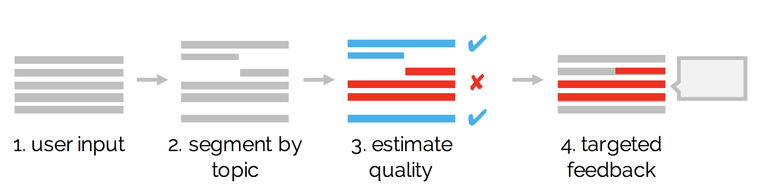
Localized Feedback is Better
How should you segment?
Out of the box segmentation algorithm (ex: by topic)
Can we re-use our document
quality model?
No! Train secondary segment-level model*
Notes:
The main idea here is that localized feedback, that tells you specifically which part of your writing to fix, is more useful than feedback at the document level.
SO, our idea is to simply break down the document into segments, predict segment quality, and then give feedback on low-quality segments
What are the two problems
How should you segment?
Can we re-use our document-level model?
This part is a technical challenge. Due to time constraints I won’t talk about how to train this model, but there’s a simple approach we use in the paper and also more complicated approaches shown in other NLP papers which we can talk about if you’re curious

Slide 20
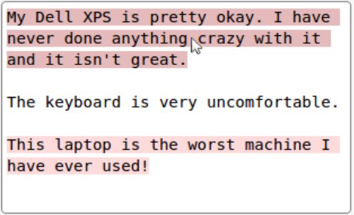
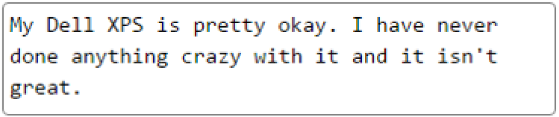
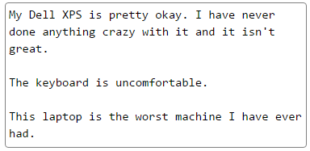

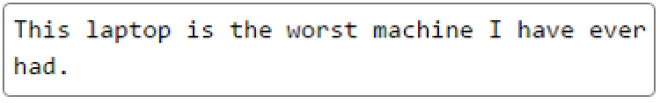
Putting it all Together
Doc
✔
✘
Seg
✔
1. User Input
2. Segment
3. Predict Quality
4. Explain how to improve segments & overall document
Amazon Example
Amazon Example
✘
This segment may be ambiguous or difficult or difficult to understand.
Try revising it for clarity.
seg
✔
seg
This segment might be too emotional. Try being more balanced.
✘
doc
This review could be expanded. Try discussing more topics such as: speed, usability, or display.
Notes:
For document, but also individual segments. The key trickiness is we only have document labels For segment, feedback, want segent model. We use weak superviison to
We use weak supervision to create quality models at the segment level.
This leads to our idea of Segment-Predict-Explain.
The idea is to break down the users writing into smaller coherent segments
Use a state of the art model to predict its quality
Then for low-quality segments or the overall document… explain
How to improve the models estimate of quality

Slide 21
Evaluation
Does our approach improve quality?
Why?
http://jmcauley.ucsd.edu/data/amazon/
https://github.com/sTechLab/AirbnbHosts-Extended
Write a review of a product you’ve owned
Write a profile for yourself as if you were an Airbnb host
Notes:
We have some data:
How do get it!
Next we evaluated our system, with 2 main questions.
We found 2 different datasets with different quality metrics
Amazon – helpfulness of reviews
Airbnb – Trustworthiness of the host to whom the listing belongs
Trained the model on each corpus to generate a custom interface
Procedure for each domain
Train model (using features from literature) to predict document quality for domain
Write explanation functions using prior work on reasons for low-quality documents
Few functions cover most inputs: 75% of Amazon reviews are unhelpful for 4 reasons (Connors et. al. 2011)
Ask Crowd to write a document
Give them feedback after they push “Submit” (independent var. – the feedback system)
Ask independent panel to score document using rubric 1-7 – (dependent var. – quality)

Slide 22
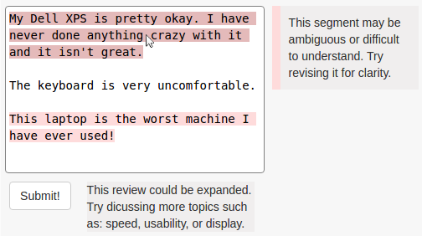
Feedback Interface
Feedback shown after submission
Revision optional
Notes:
Next we evaluated our system, with 2 main questions.
We found 2 different datasets with different quality metrics
Amazon – helpfulness of reviews
Airbnb – Trustworthiness of the host to whom the listing belongs
Trained the model on each corpus to generate a custom interface
Procedure for each domain
Train model (using features from literature) to predict document quality for domain
Write explanation functions using prior work on reasons for low-quality documents
Few functions cover most inputs: 75% of Amazon reviews are unhelpful for 4 reasons (Connors et. al. 2011)
Ask Crowd to write a document
Give them feedback after they push “Submit” (independent var. – the feedback system)
Ask independent panel to score document using rubric 1-7 – (dependent var. – quality)

Slide 23
Independent Variable: Feedback System
Segment Level Feedback?
No
Yes
Baseline
Baseline+Segment
No
Perturbation
Analysis?
Baseline+Perturb
Perturb+Segment
Yes
Notes:
Call it dialectic not full system
Next we evaluated our system, with 2 main questions.
We found 2 different datasets with different quality metrics
Amazon – helpfulness of reviews
Airbnb – Trustworthiness of the host to whom the listing belongs
Trained the model on each corpus to generate a custom interface
Procedure for each domain
Train model (using features from literature) to predict document quality for domain
Write explanation functions using prior work on reasons for low-quality documents
Few functions cover most inputs: 75% of Amazon reviews are unhelpful for 4 reasons (Connors et. al. 2011)
Ask Crowd to write a document
Give them feedback after they push “Submit” (independent var. – the feedback system)
Ask independent panel to score document using rubric 1-7 – (dependent var. – quality)

Slide 24
Does our approach improve quality?
Scored quality using 3 judges on a 1-7 scale
Yes! > 14% quality increase w/ full system in both domains
> 3x better than state of the art
Notes:
We had 3 experts rate quality on 1-7 scale – slide b4
Add total number of submission

Slide 25
Example Amazon User
Linguistic Feature: Subjectivity
Feedback: Please consider writing a more balanced review
I currently own an HP laptop that has done nothing but good for me. I had been an Apple fan for the longest time but I decided because I wanted to work more on Mturk, I wanted to be more focused on getting a PC because a lot of scripts and a lot of surveys are more PC friendly. Also, for my personal gain it would be cheaper to get a PC. I can't think of an instance where this PC has done me much wrong. The battery life is pretty average, but I don't usually leave my PC off of the charger so that's not too terribly much of an issue. The speed is good, and I can manage to use multiples apps and have multiple tasks open at the same time. The design is pretty clean too, with a solid build quality and a solid means of build structure. The camera is alright, it is what it is but it's not something I really looked for. This laptop does everything I need it to do, and that is something I am more than pleased with. I can't think of any glaring issues with the product in question. Some of the facing of the keyboard can be a bit slippery and I do think it is a little inconvenient that the volume up and airplane mode buttons are right next to each other. I've definitely clicked on one that I shouldn't have previously.

Slide 26
Example Airbnb User
Linguistic Feature: Topic usage
Feedback: Please consider adding more info about your personal life
We are a married couple in our mid 20's. We both work full time and are also youth pastors. This keeps us fairly busy, but we also love spending time out in the community, particularly at the oceanfront which is only about 2 miles from our house. We're both Air Force brats, but have spent a fair amount of our lives in the area, so we can help you with any questions you may have! Please feel free to let us know if you have any questions, we are always here but want to respect your privacy as well.

Slide 27
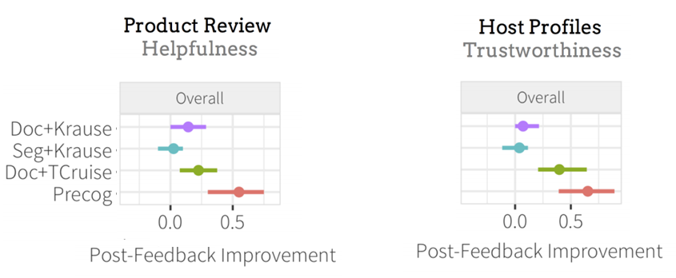
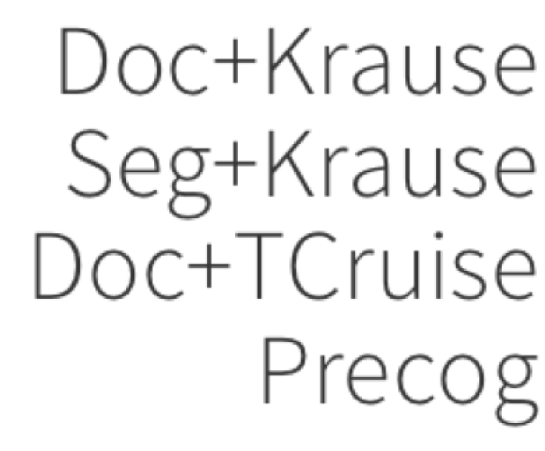
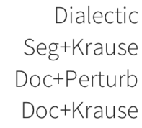
Why?
Segment Level Feedback?
No
Yes
Baseline
Baseline+Segment
No
Perturbation
Analysis?
Baseline+Perturb
Perturb+Segment
Yes
Amazon Reviews
Airbnb Profiles
Baseline
Baseline+Segment
Baseline+Perturb
Dialectic
Notes:
Only show purple and red
We look at them indivduiuall and combined to see what improves in which case
----
Points, axes, lines.
-----
X is this. Circle is this. Line is confidence. Left is Amazon. Right is Airbnb.
Make bigger
Make labels consistent
Colors consistent
Localization isn’t useful unless you are picking good feedback
Even without localization you get improvements
Longer
Let’s look at Amazon first.
So the Y axis is the condition, and X axis is the amount the average
Document improved after receiving feedback.
Our full system performed the best out of all 4 conditions
Individually giving segment level feedback or perturb analysis isn’t enough
You need to combine them to get a statistically significant improvement
We think this is because to give feedback on segments, you need a more
Advanced feedback mechanism than Krause, which is why Baseline+Segment fails
But also doing perturbation analysis is less useful when you just constrain it
To big picture feedback at the document level.
And then… we get basically the same results on Airbnb (CLICK)
* Why does baseline+perturb and precog overlap in airbnb? Would user quotes help explain?
* May be worth a slide that contains 1 or 2 user quotes to better describe results in the "Why?" slide.

Slide 28
Conclusion
Quality Prediction + Perturbation Analysis
(Model Explanation)
= Writing feedback!
Segment-feedback works for long text
Notes:
Merge first and second row into one
Scaling social media feedback = quality predict.+ perturb
+ segment (longer text)
We show that a great way to improve quality is
Just to change the interface
Segment, Predict, Explain → Great for improving quality
Segment + Predict necassery
Interesting questions in Education:
More complicated task of feedback to students writing essays
Does using an automated feedback system make you a better writer over time
Name, email address, website

Slide 29
Thank You!
Questions:
Hamed Nilforoshan
hamedn.com
hn2284@columbia.edu

